Slide 1
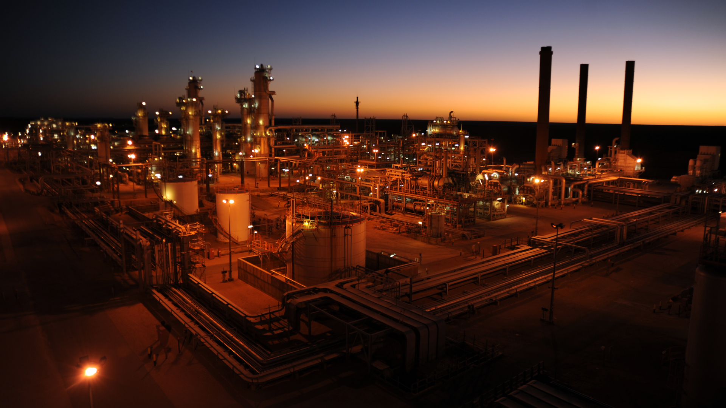
Username
Password
Login
Forget my password

Slide 2

New Project
Project Management
Project Name
Create New Project
Project List
Package No.
Zone
Type
User Management
Create New User
District
Division
Country
User List
Client Management
Project Owner
EPC Contractor
Create New Client
Client List
Contract Date
Execution starts
System Log
Cons. Time
Site Handover Delay
Setting
Scheduled date of completion
Actual Completion Date
Equivalent Currency
Chose Currencies
Project value C1
Exchange Rate
Equivalent Project Value
Project value C2
Exchange Rate
Project value C3
Exchange Rate
Import from Excel
Discard
Save

Slide 3






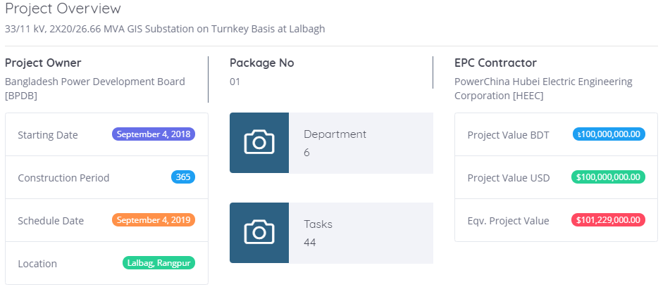
Project Management
Create New Project
Edit Project
Project List
Overview
Tasks
Departments
Status
Dept. Task
Users
. . .
User Management
Create New User
User List
Client Management
Create New Client
Client List
System Log
Setting

Slide 4
Project Management
Create New Project
Edit Project
Project List
Overview
Tasks
Departments
Status
Dept. Task
Users
. . .
User Management
Task Tree
New Tasks
Create New User
User List
SL
Task Name
Origin
Unit
Qty
Task Value
Task Name
Client Management
Create New Client
Origin
Unit
Quantity
Client List
System Log
Setting
C1 Value %
C2 Value %
C3 Value %
Eq. Task Value %
Discard
Save

Slide 5

Project Management
Create New Project
Edit Project
Project List
Overview
Tasks
Departments
Status
Dept. Task
Users
. . .
User Management
Task Tree
New Tasks
Create New User
User List
SL
Task Name
Origin
Unit
Qty
Task Value
Task Name
Client Management
1
33kV GIS
EU
Set
2
28.512324
Create New Client
Origin
Unit
Quantity
Client List
System Log
Setting
C1 Value %
C2 Value %
C3 Value %
Eq. Task Value %
Discard
Save

Slide 6
Project Management
Create New Project
Edit Project
Project List
Overview
Tasks
Departments
Status
Dept. Task
Users
. . .
User Management
Task Tree
33kV GIS
Create New User
User List
SL
Task Name
Origin
Unit
Qty
Task Value
Task Name
Client Management
1
33kV GIS
EU
Set
2
28.512324
33kV GIS
Create New Client
Origin
Unit
Quantity
Client List
EU
Set
2
System Log
Setting
C1 Value %
C2 Value %
C3 Value %
Eq. Task Value %
28.512324
Add Sub
Discard
Update

Slide 7
Project Management
Create New Project
Create New Project
Edit Project
Project List
Overview
Tasks
Departments
Status
Dept. Task
Users
. . .
User Management
Task Tree
New Subtask
Create New User
User List
SL
Task Name
Origin
Unit
Qty
Task Value
Task Name
-
28.512324
Client Management
1
33kV GIS
EU
Set
2
33kV GIS
Create New Client
1.1
33kV incoming feeder panel
EU
Set
2
28.512324
Subtask Name
Client List
System Log
Origin
Unit
Quantity
Setting
C1 Value %
C2 Value %
C3 Value %
Eq. Task Value %
Discard
Save

Slide 8
Project Management
Create New Project
Edit Project
Project List
Overview
Tasks
Departments
Status
Dept. Task
Users
. . .
User Management
Task Tree
Create New User
Subtask One of 33kV GIS
User List
SL
Task Name
Origin
Unit
Qty
Task Value
Task Name
-
28.512324
Client Management
1
33kV GIS
EU
Set
2
33kV GIS
Create New Client
1.1
33kV incoming feeder panel
EU
Set
2
28.512324
Subtask Name
Client List
Subtask One of 33kV GIS
System Log
Origin
Unit
Quantity
Setting
EU
Set
2
C1 Value %
C2 Value %
C3 Value %
Eq. Task Value %
28.512324
Add Root
Discard
Save

Slide 9
Project Management
Create New Project
Edit Project
Project List
Overview
Tasks
Departments
Status
Dept. Task
Users
. . .
User Management
Task Tree
Root One of 33kV GIS
Create New User
User List
SL
Task Name
Origin
Unit
Qty
Task Value
Task Name
-
28.512324
Client Management
1
33kV GIS
EU
Set
2
33kV GIS
1.1
33kV incoming feeder panel
EU
Set
2
28.512324
Create New Client
-
Subtask Name
Client List
1.1.1
33kV GIS
EU
Set
2
28.512324
33kV incoming feeder panel
System Log
Root Name
Setting
Line isolator
Origin
Unit
Quantity
EU
Set
2
C1 Value %
C2 Value %
C3 Value %
Eq. Task Value %
28.512324
Discard
Save

Slide 10
Project Management
Create New Project
Edit Project
Project List
Overview
Tasks
Departments
Status
Dept. Task
Users
. . .
User Management
Department List
Create New User
New Department
User List
SL
Department Name
Department Value
Client Management
Department Name
Create New Client
Client List
Department Value
System Log
Setting
Discard
Save

Slide 11
Project Management
Create New Project
Project List
Overview
Tasks
Departments
Status
Dept. Task
Users
Edit Project
. . .
User Management
Create New User
Select Department
New Status
User List
Client Management
Select Department
Status List
Create New Client
Client List
Status Name
Status Value
Status Name
System Log
Setting
Status Value
Discard
Save

Slide 12
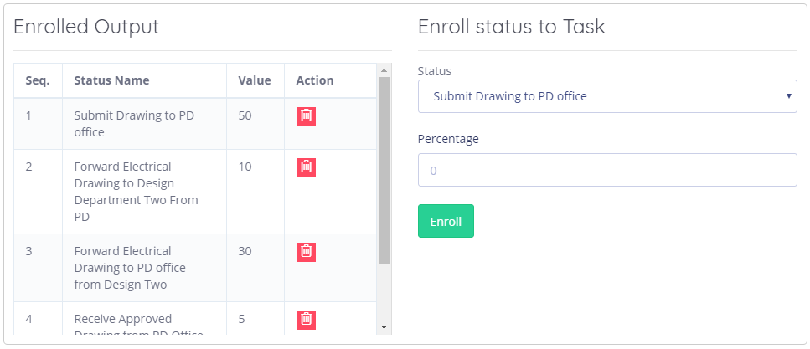
Project Management
Create New Project
Edit Project
Project List
Overview
Tasks
Departments
Status
Dept. Task
Users
. . .
Options
User Management
Create New User
Select Department
User List
Client Management
Status List : Department
Create New Client
SL
Client List
Status Name
Starting Date
Ending Date
Moderator
System Log
1
-
Status Name
Starting Date
Ending Date
Moderator
1.1
-
Status Name
Starting Date
Ending Date
Moderator
Setting
1.1.1
Status Name
Starting Date
Ending Date
Moderator
1.1.2
Status Name
Starting Date
Ending Date
Moderator

Slide 13
Project Management
Create New Project
Edit Project
Project List
Overview
Tasks
Departments
Status
Dept. Task
Users
. . .
User Management
Department List
Create New User
Assign User
User List
Users Name
Users Role
Department Name
Client Management
Assign User Role
Create New Client
Client List
Department Name
System Log
Setting
Select User
Discard
Save

Slide 14
Edit Project
Project Management
Project Name
Create New Project
Project List
Package No.
Zone
Type
User Management
Create New User
District
Division
Country
User List
Client Management
Project Owner
EPC Contractor
Create New Client
Client List
Contract Date
Execution starts
System Log
Cons. Time
Handover Delay
Setting
Scheduled date of completion
Actual Completion Date
Equivalent Currency
Chose Currencies
Project value C1
Exchange Rate
Equivalent Project Value
Project value C2
Exchange Rate
Project value C3
Exchange Rate
Import from Excel
Discard
Save

